Slide 1


Excel Engineering College , Komarapalayam (DEPARTMENT OF MCA) BATCH 2023-2025 MINI PROJECT(23PMC306) A MINI PROJECT REPORT ON
Pharmacy Information System : A Framework for Automated Prescription and Real-Time Stock Monitoring
Submitted By
VISHAL KUMAR SINGH
Roll No : 23MCA59
Reg No : 730923632059
Under the guideline of
Mr. M. K. Nageswaran

Slide 2
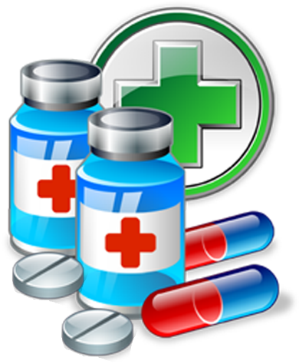
MCA DEPARTMENT |
PROJECT
PROJECT TITLE
SUBMITTED TO GUIDANCE
SUBMITTED BY
Pharmacy Information System : A Framework for Automated Prescription and Real-Time Stock Monitoring
Mr. M. K. Nageswaran
VISHAL KUMAR SINGH

Slide 3
ABSTRACT
Pharmacy Information control mechanisms tailored within a Profit management framework to maximize resource cost has been proposed.
Existing abstractions for in-memory storage on clusters, such as distributed shared memory, key value stores, databases, and Piccolo, offer an interface based on fine-grained updates to mutable state (e.g., cells in a table).
It is fine-tuned to predict the load of its cluster. The final load of the whole grid is obtained by summing the loads of each cluster.

Slide 4
OBJECTIVES
Automate Prescription Management:
Streamline the process of generating, managing, and tracking prescriptions
Reduce human errors in prescription creation and medication dispensin.
Real-Time Stock Monitoring:
Continuously monitor inventory levels to ensure medications are adequately stocked.
Provide real-time alerts for low stock, expired medications, or items approaching expiry.
Improve Efficiency and Accuracy:
Eliminate manual processes to reduce inefficiencies in handling prescriptions and inventory.
Ensure data accuracy in stock levels, prescriptions, and reports.

Slide 5
SYSTEM SPECIFICATION
HARDWARE REQUIREMENTS:
Processor Type : Intel i5
RAM : 8GB DD4 RAM
Hard disk : 1TB
Keyboard : 101/102 Standard Keys
SOFTWARE REQUIREMENTS:
Operating System : Windows 11
Front end : Net beans IDE / jdk21
Back end : Mysql workbench /Mysql 8.0CE
Coding Language : Java , Mysql

Slide 6
EXISTING SYSTEM
Scientific applications partially or entirely shifting from traditional computing platforms (e.g., grid) to the cloud. Due to the pay-as-you-go computational behaviour, performance and (monetary) cost optimizations have recently become a hot research topic for workflows in the cloud.
To address the limitations of current approaches, propose Profit Maximization, a transformation-based optimization framework for optimizing the performance and cost of workflows in the cloud.
Profit Maximization models the cost and performance optimizations of workflows as transformations.
It performance and monetary cost optimizations for workflows from various applications in the cloud have become a hot research topic.

Slide 7
DRAWBACKS OF EXISTING SYSTEM
Problem To maintain record of daily transactions.
They have Work load so they Also have problem in dealing with their customer.
At the End of the they also have problem in calculating their profit, sales Purchases etc,.

Slide 8
PROPOSED SYSTEM
Automate Prescription Handling:
Provide an efficient platform for pharmacists to manage patient prescriptions. This includes generating, processing, and dispensing prescriptions in an organized and accurate manner.
Reduce manual errors in interpreting prescriptions by digitizing the entire process, ensuring precise medication dispensation.
Real-Time Stock Monitoring:
Continuously track the availability of medications in the pharmacy, ensuring that stock levels are updated in real time.
Alert pharmacists or administrators when stock levels are low, preventing shortages and ensuring that all prescribed medicines are available when needed.

Slide 9
Improve Workflow Efficiency:
Minimize the time spent on manual stock checks and prescription filing by automating repetitive tasks.
Provide pharmacists with instant access to medicine availability, speeding up the prescription fulfillment process and enhancing customer service.
Ensure Accurate Medication Dispensation:
By integrating prescription data with the stock system, the system ensures that the right medications are dispensed based on available inventory, avoiding errors related to stock unavailability or incorrect dosages.

Slide 10
MODULE DESCRIPTION
The module that is used in the PHARMACY INFORMATION SYSTEM : A FRAMEWORK FOR AUTOMATED PRESCRIPTION AND REAL-TIME STOCK MONITORING in computerized by using java.
Main Panel
Login
User Registration
Create User
Change Password
Medicines
Insert Medicines
Medicines Panel
Update Medicines

Slide 11
Sales Record
New Sales Record
Product Category
Add Category
Companies
Companies Panel
Insert Company
Update Company
Connection to Database

Slide 12
SYSTEM FLOW DIAGRAM
Login
Main Panel
Pharmacy Information System
User Registration
Companies
Create User
Product Category
Change Password
New Sales Record
Sales Record

Slide 13
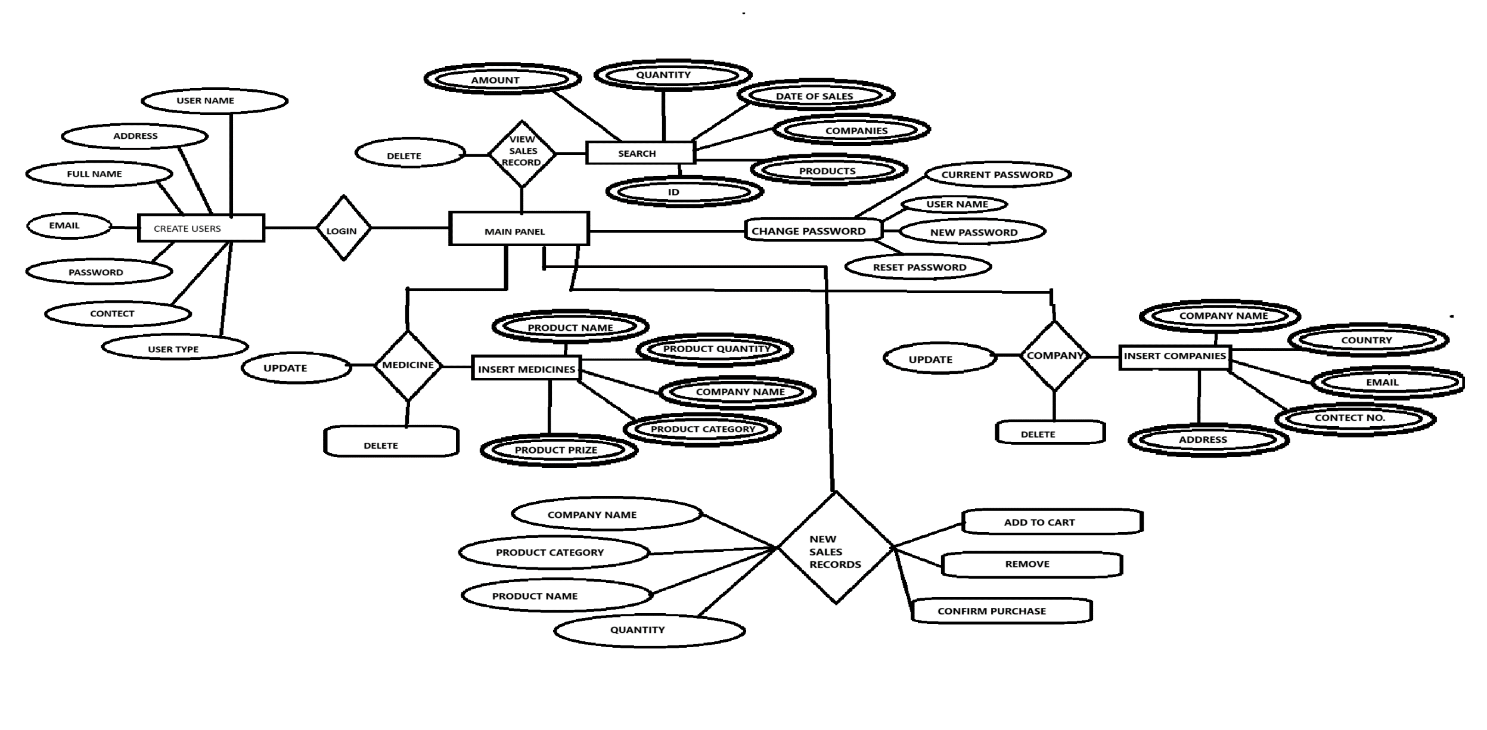
ENTITY RELATIONSHIP DIAGRAM

Slide 14
DATABASE DIAGRAM
Pharmacy Information System
company
users
sales_record
Products
product_category

Slide 15

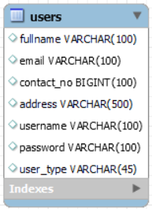
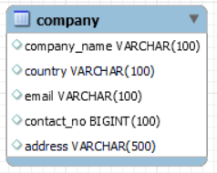
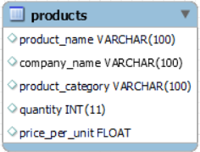
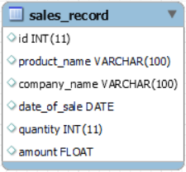
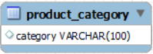
DATABASE DIAGRAM
medical

Slide 16
Testing
Unit Testing: Test individual components like prescription processing, stock update.
Integration Testing: Ensure modules like Prescription and Stock Monitoring work together seamlessly.
User Acceptance Testing (UAT): Ensure the system meets pharmacy staff requirements and is easy to use.
Test Cases: Document sample test cases for prescription entry, stock alerts, and user login.

Slide 17
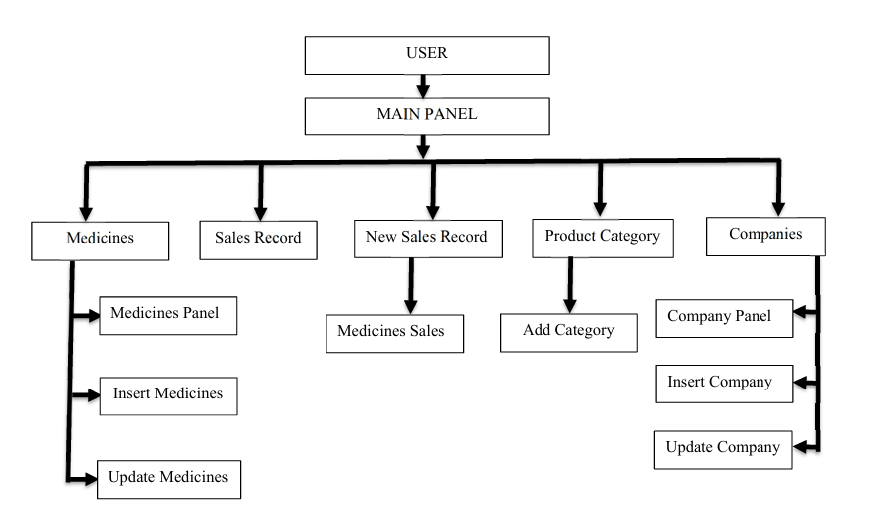
ARCHITECTURE

Slide 18
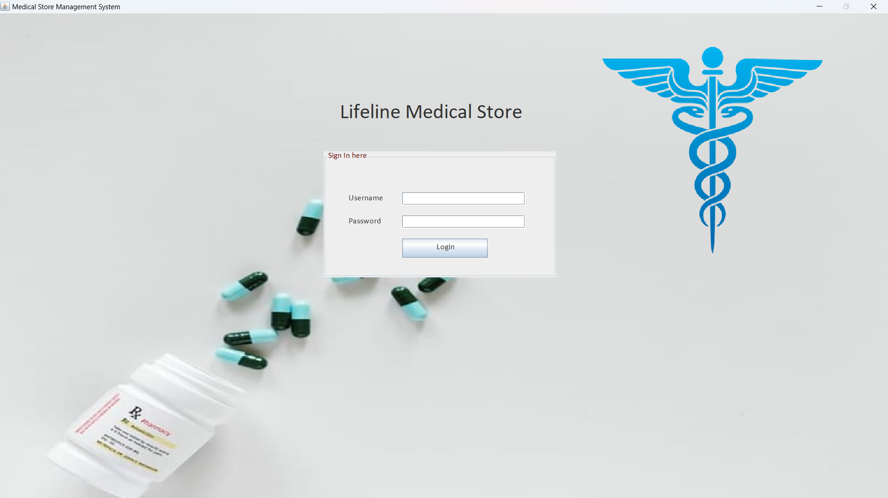
Screenshots

Slide 19
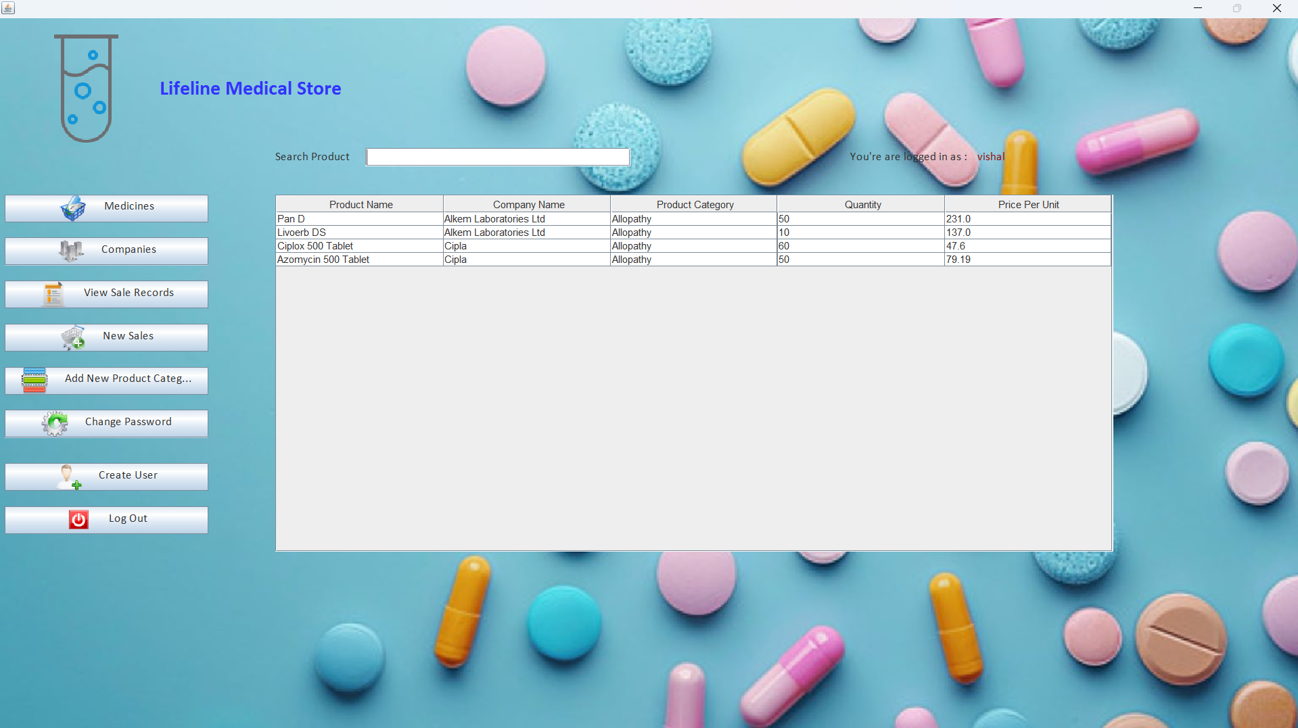
Screenshots

Slide 20
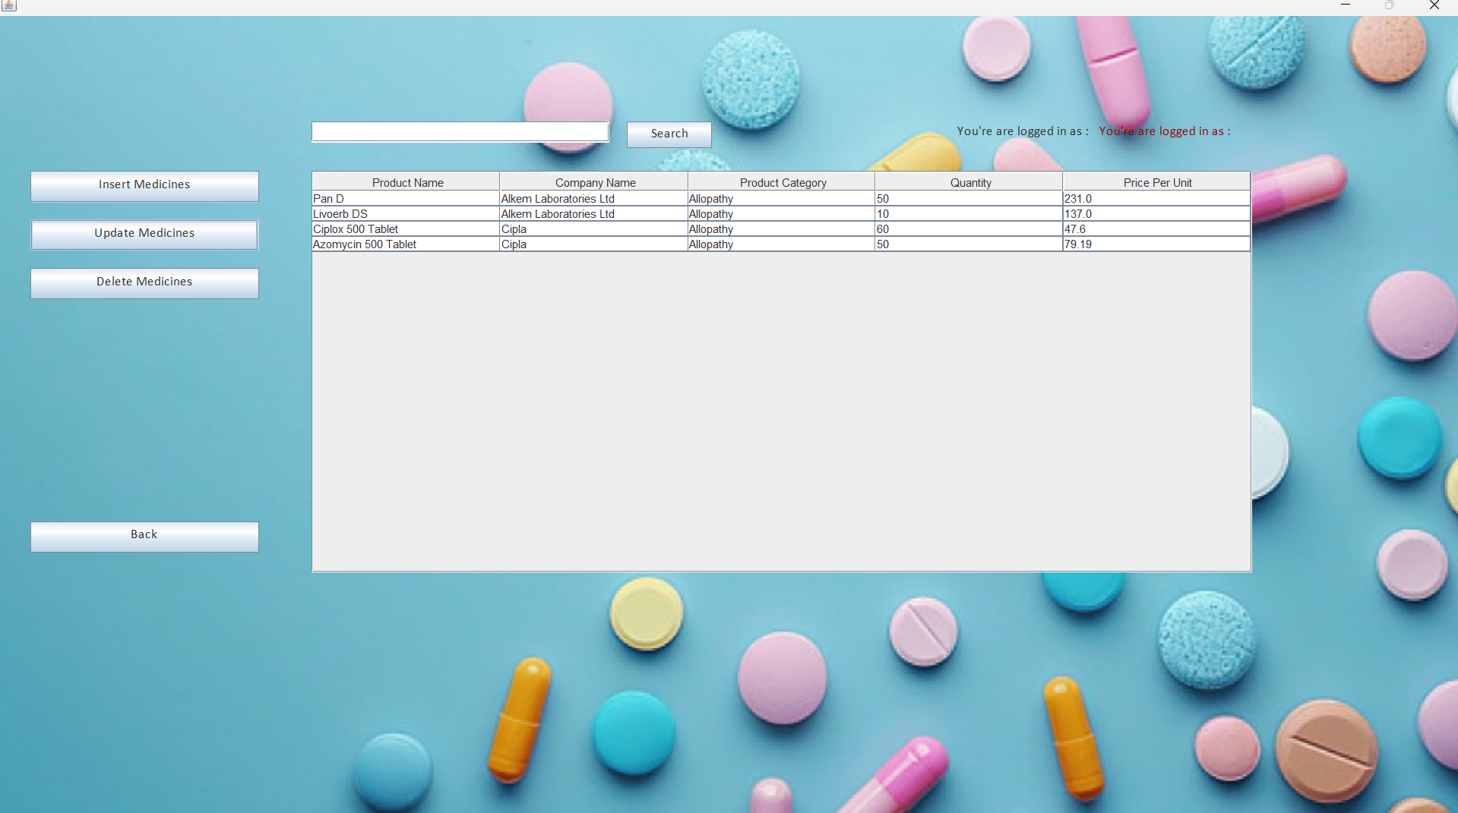
Screenshots

Slide 21
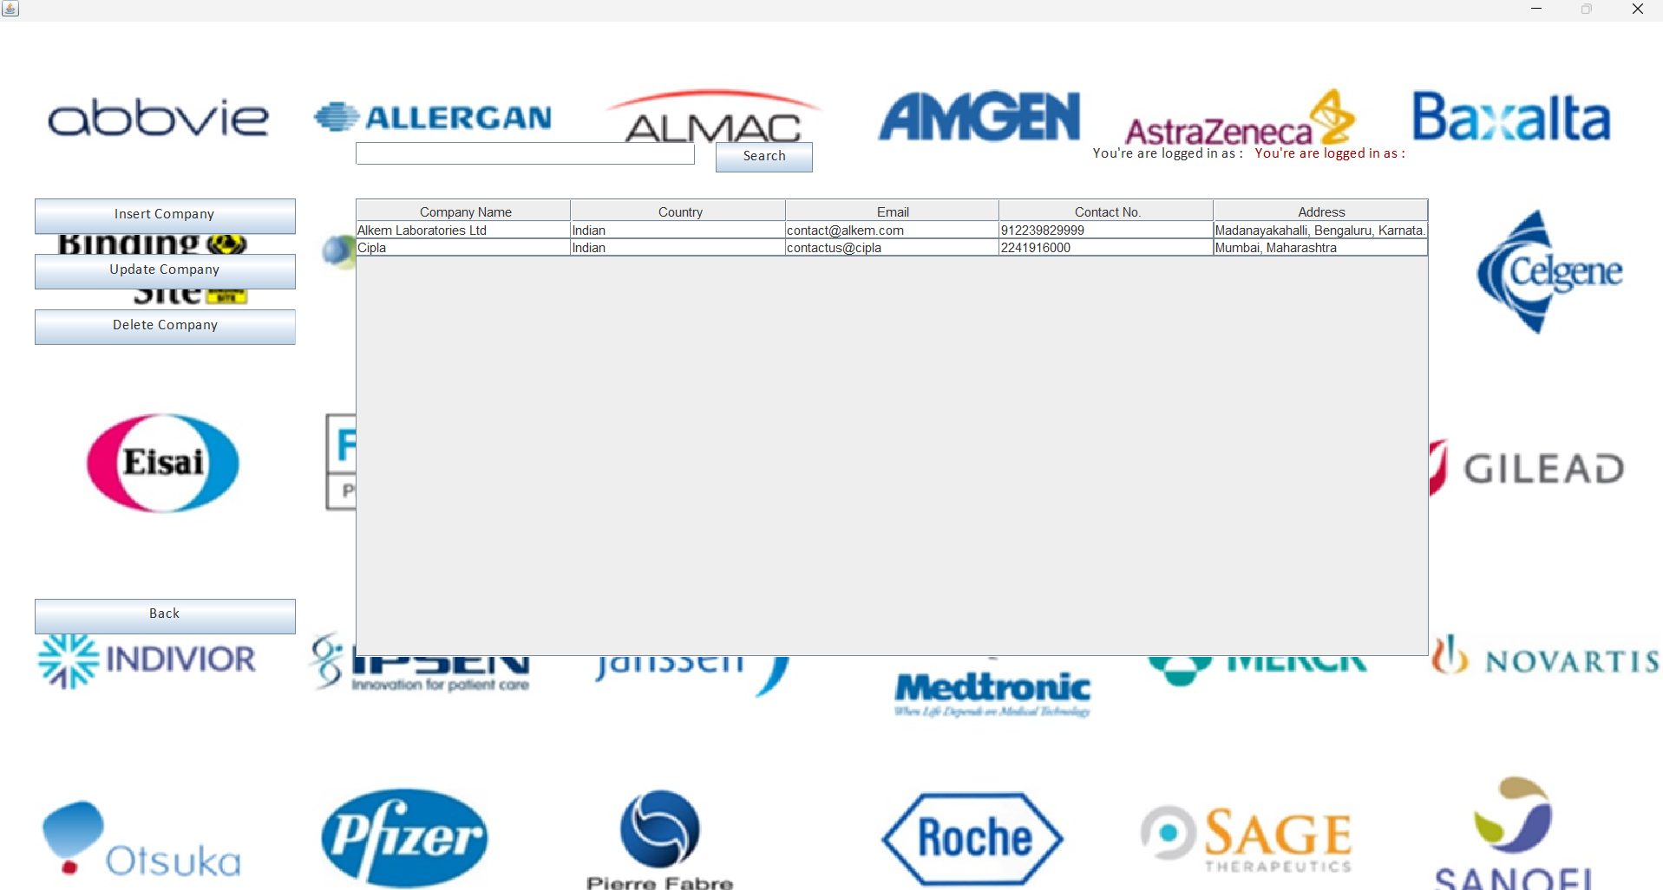
Screenshots

Slide 22
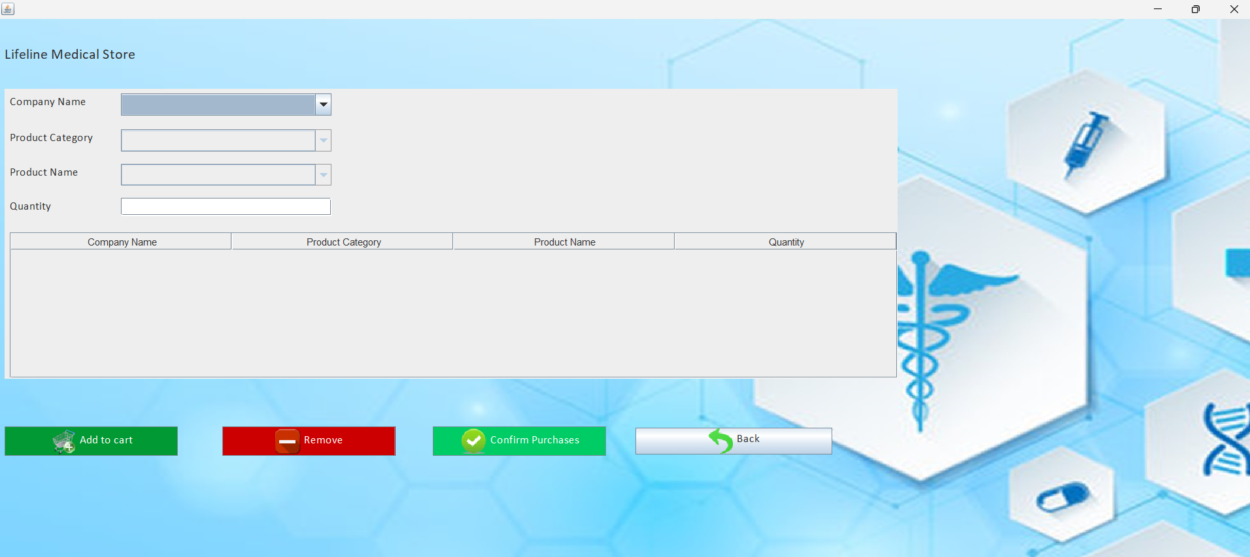
Screenshots

Slide 23
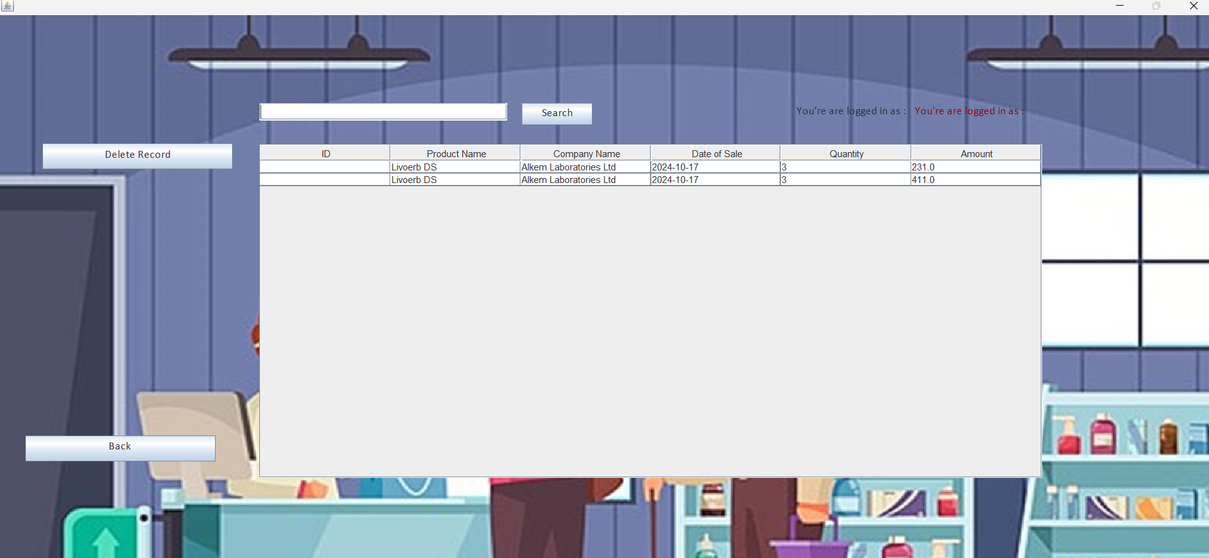
Screenshots

Slide 24
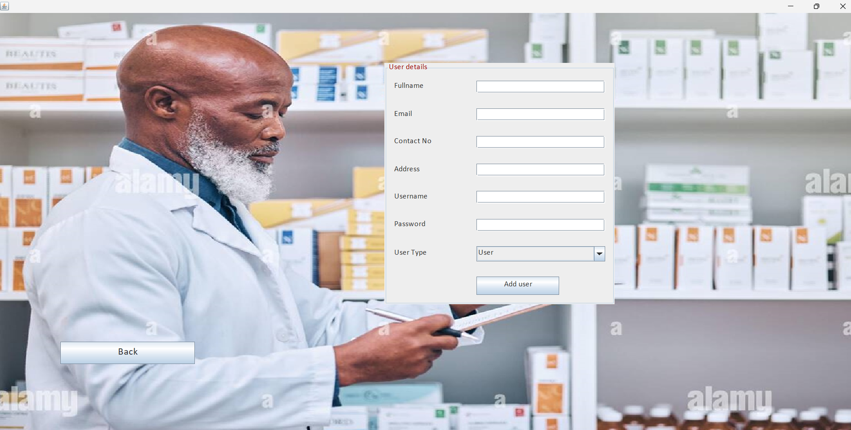
Screenshots

Slide 25
FEATURE
The "pharmacy information system: a framework for automated prescription and real-time stock monitoring" project, focusing on the report features. You can adjust these according to your specific project needs:
Prescription Management Report
Purpose: Provides a detailed overview of all prescriptions issued over a specified period.
Real-Time Stock Report
Purpose: Monitors stock levels in real-time and provides insights into inventory.
Sales and Revenue Report
Purpose: Shows revenue generated through sales of medications and prescriptions.
Supplier Inventory Report
Purpose: Tracks inventory supplied by different vendors and suppliers.
Pharmacy Performance Report
Purpose: Provides insights into the overall performance of the pharmacy.

Slide 26
Conclusion
Summarize lessons learned from the development process.
Highlight key achievements and improvements made to traditional systems through automation.
Add a reflection on future scalability and how the system could evolve with the needs of modern healthcare.
The system provides an intuitive, easy-to-use interface for pharmacists, doctors, and administrative staff.
Minimal training is required, allowing users to quickly adapt to the system.

Slide 27
Future Work
Propose the integration of predictive analytics to forecast future medicine demands based on historical trends.
Discuss the integration of IoT (Internet of Things) for monitoring drug storage conditions (e.g., temperature-sensitive medicines).
Mention plans for multi-lingual support or localization if the system will be deployed in different regions or countries.
Explore cloud-based deployment to make the system available from anywhere, reducing infrastructure costs.

Slide 28
THANK YOU

